Slide 1
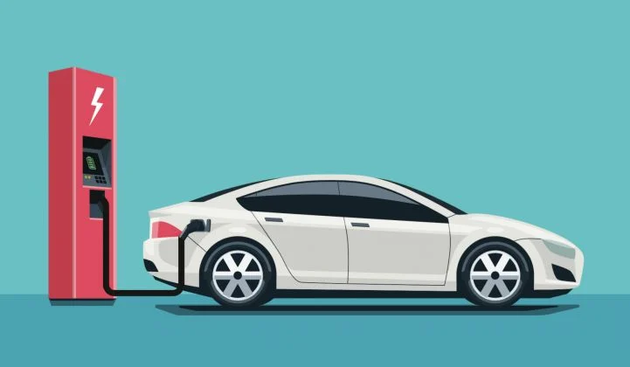
Electric Cars
Student’s name
Tutor’s name
Institution
Date

Slide 2
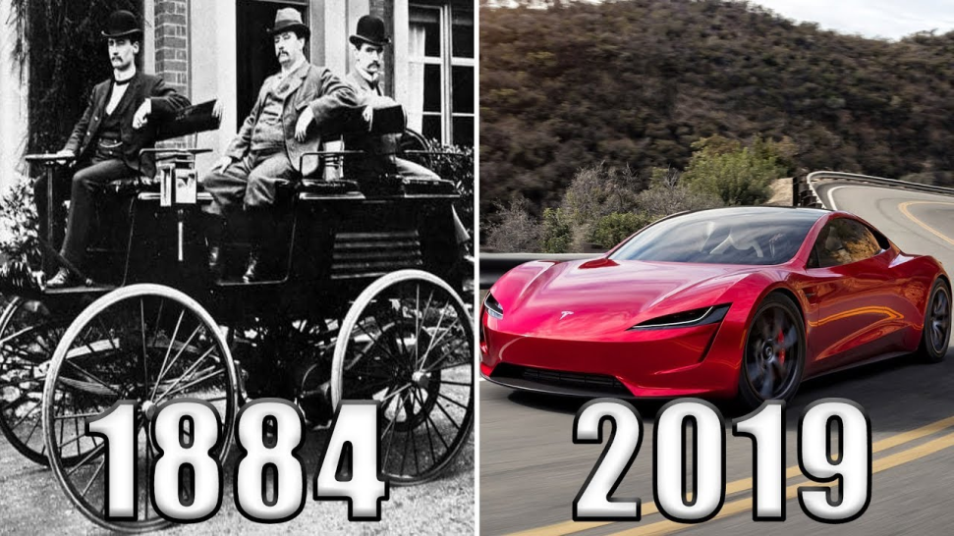
Timeline
Electric cars are not an invention of modern times.
The first crude electric vehicle was built in England.
The first electric vehicle debuted in the US in 1889-1991 (Averidis, 2020).

Slide 3
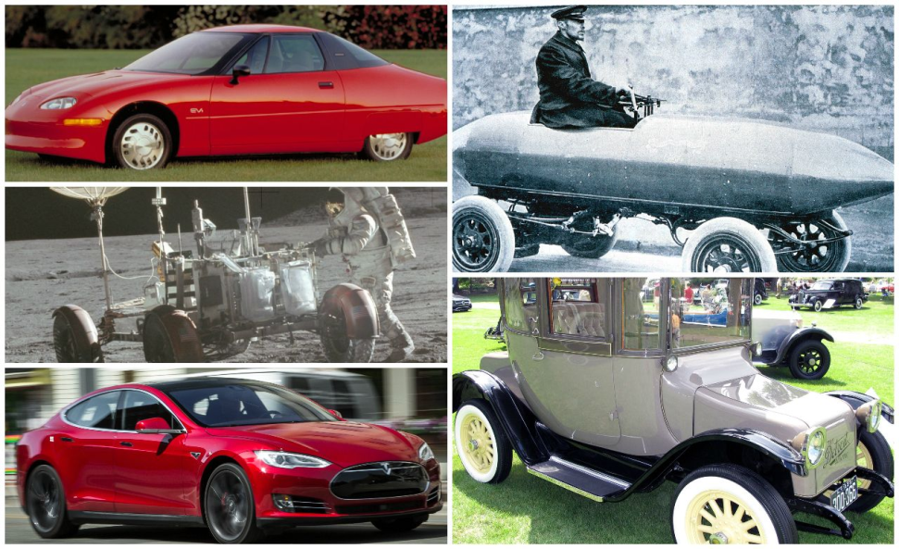
Timeline cont.
They gained popularity in 1899 because they did not smell like pollutants.
Gas powered cars started taking over in 1912 because they were cheaper.
By 1935, they had all but disappeared.

Slide 4
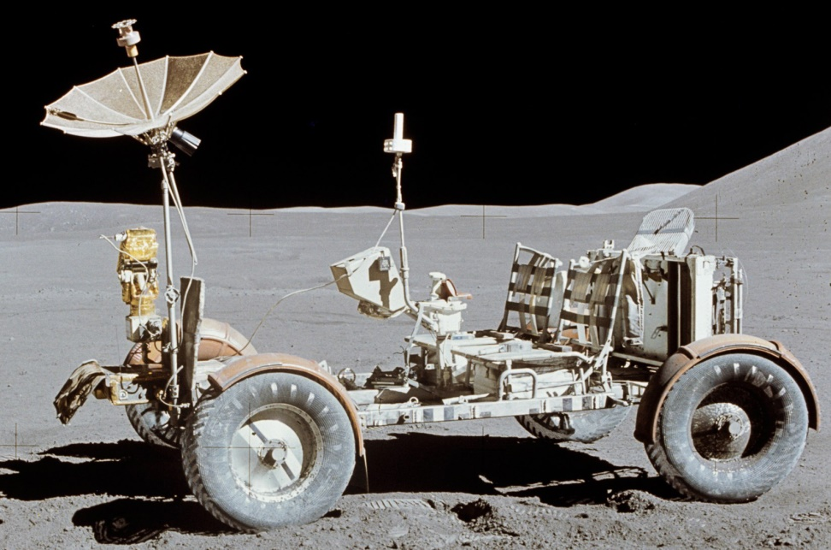
Getting interest again
Gas prices soared in the 1970s.
NASA’s Lunar Rover, powered by electricity, raised electric cars’ profiles.
In 1973, General Motors displayed the first prototype of an urban electric car.
In 1975, Sebring-Vanguard’s CitiCar sold over 2000 units.
Due to limitations, interest in electric cars faded again.

Slide 5
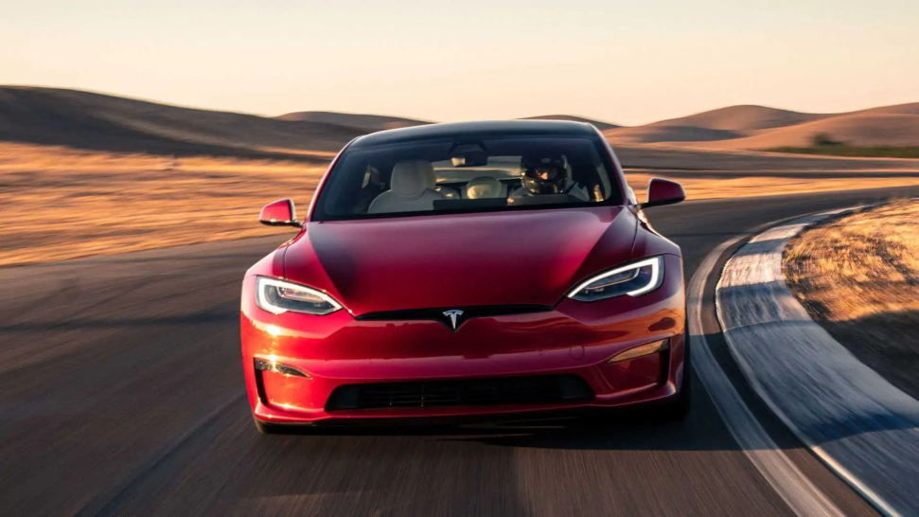
Modern electric cars
In 2006, Tesla Motors, a Silicon Valley start-up, started producing luxury electric sport cars.
Other automakers accelerated their work on electric cars.
The Energy department has invested in nation-wide charging infrastructure, which enables customers to charge their cars at their convenience.

Slide 6
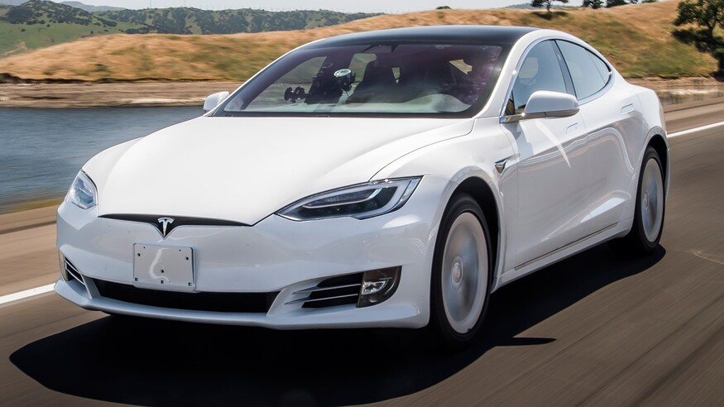
Battery’s costs
In 2013, the cost of batteries dropped by over 50%, which made electric cars affordable for consumers (Aruna & Prabhu, 2021).
Currently, all automakers are racing to catch up with Tesla.

Slide 7

Government Regulations
The shift to electric vehicles is mostly fuelled by government policies.
The European Union proposed tough regulations on carbon emissions.
California and Massachusetts have announced to ban cars with combustion engines by 2035 (Aruna & Prabhu, 2021).
The federal government also decided to ban combustible engines by 2035.

Slide 8
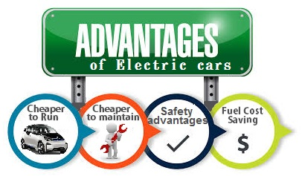
Advantages
Electric cars do not need gas.
This will save Americans $2000 to $4000 a year (Averidis, 2020).
Electric cars are more convenient, easy to charge and don’t need gas stations.
No carbon emissions come from electric cars.
They are also low maintenance since their engines are electrically powered.

Slide 9
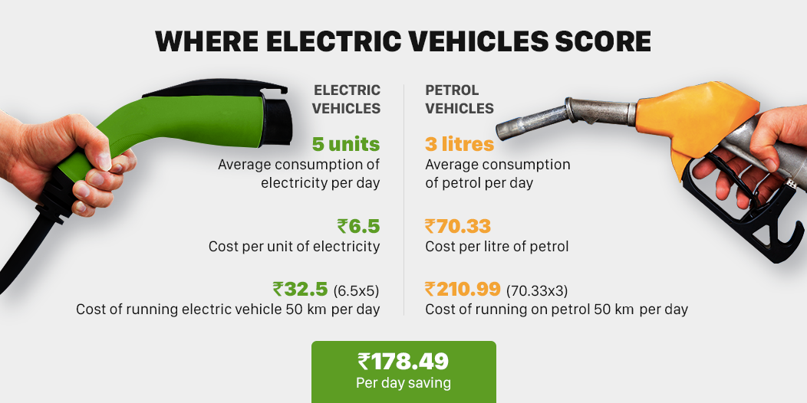
Disadvantages
Recharge points are still in the developmental stage.
The initial investment is high.
The most affordable ones go for $30,000 to 40,0000 (Averidis, 2020).
Electricity bills will shoot up.
They have a short driving range and speed.

Slide 10
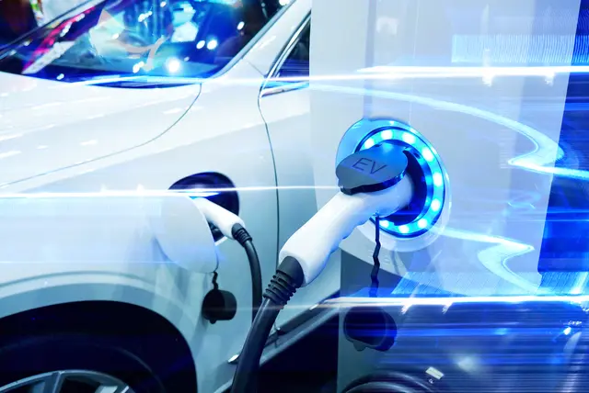
Conclusion
Although electric cars may have their issues, they are more environmentally friendly, and the globe needs that now.
They promise a greener future with less carbon emissions.

Slide 11
References
Aruna, P., & Prabhu, V. V. (2021). Evolution and Recent Advancements in Electric Vehicle (EV) Technology. In Emerging Solutions for e-Mobility and Smart Grids (pp. 91-109). Springer, Singapore.
Ayeridis, G. (2020). Electric cars: history and perspectives.

